Slide 1

Miguel Guzman
Karch McCoy
Jamie McNeely
Júlio Zynger

Slide 2
Proposal
Android App
Utility for Incoming Students
Open Source Code for IT
  https://code.google.com/p/sandtvirtualtours/
Notes:
Jamie

Slide 3
Requirements
Virtual tour of campus
Directions to buildings
    Locate a Department’s Building
Frequently Asked Questions
Notes:
Jamie

Slide 4
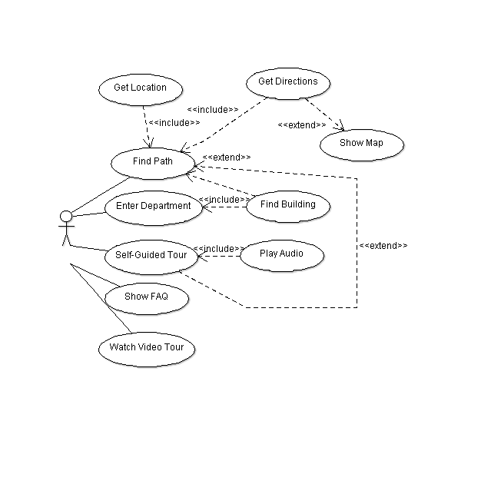
Use Cases
Student
Notes:
Miguel

Slide 5
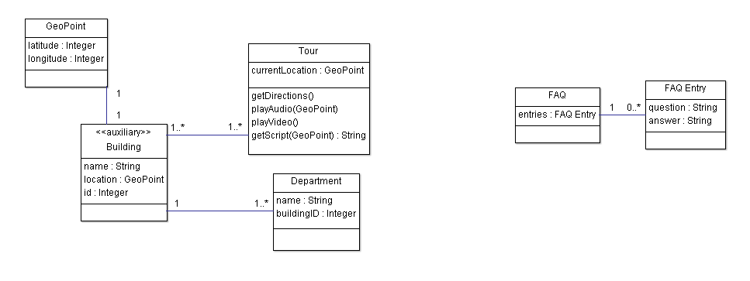
Class Diagram
Notes:
Miguel

Slide 6
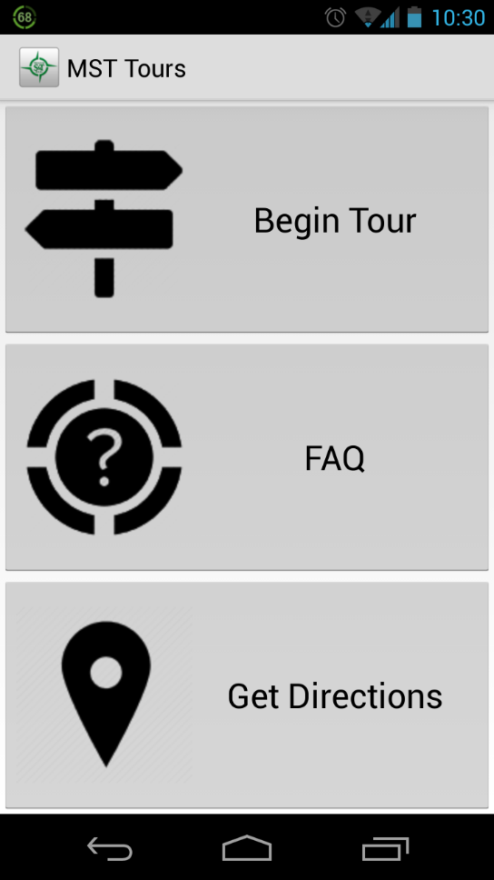
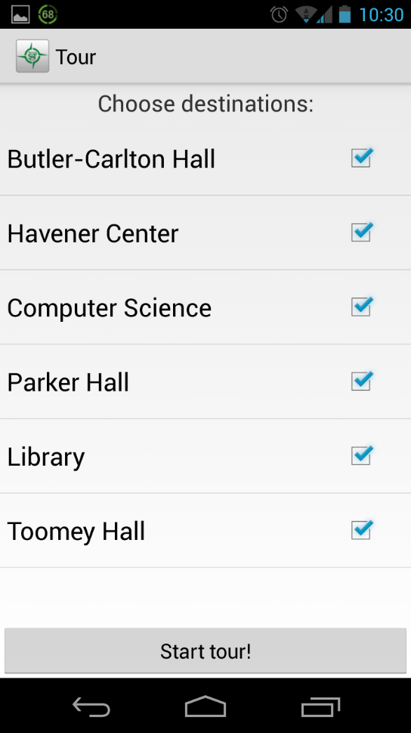
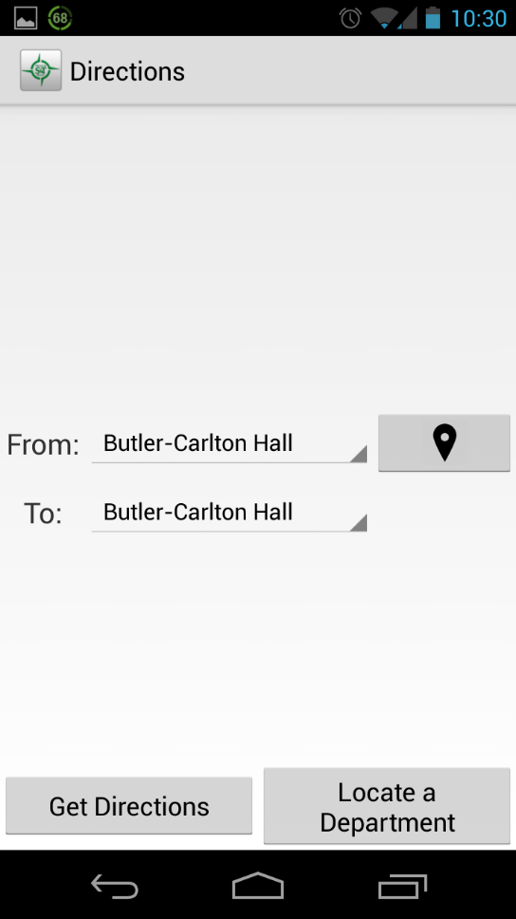
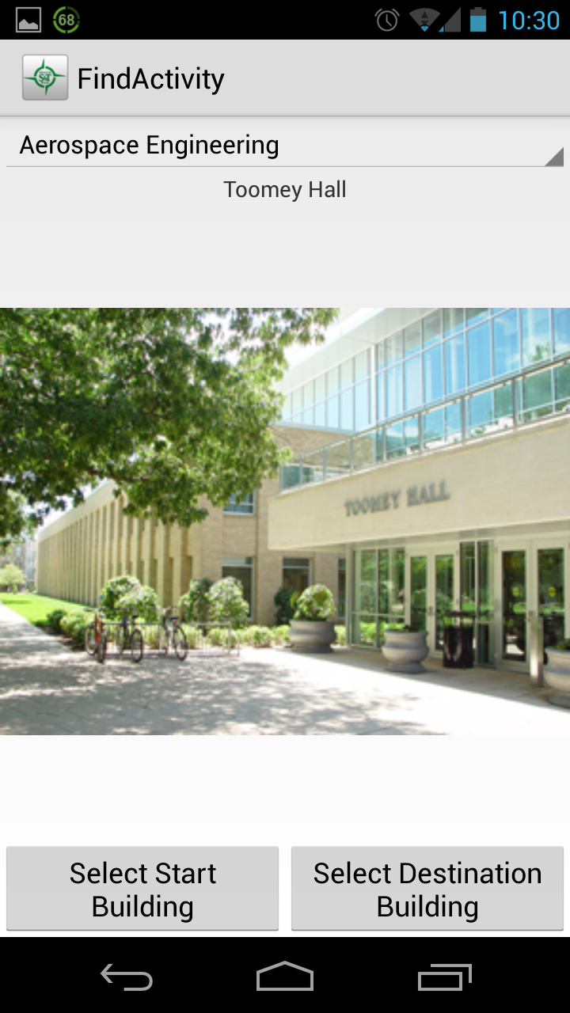
Implementation
Built with Java & XML
Notes:
Julio

Slide 7
Prototyped
Not all campus buildings
Not all departments
FAQ incomplete
Very Easy To Finish
Notes:
Julio

Slide 8
Sample XML
<building>
<name>Havener Center</name>
<lat>37.95470937643882</lat>
<lng>-91.77638947963715</lng>
<img>http://swtdesign.com/wp-content/gallery/missouri-st-havener-center-and-student-center-plaza/080722_umr- 10.jpg</img>
</building>
Notes:
Karch

Slide 9
Demo

Slide 10
What Went Wrong
Needed permission to make a video tour
Never received a full FAQ
Google Maps API Limitations
Time
Notes:
Karch

Slide 11
Future Work
Add in what’s missing
Record and add Video Tour
Implement audio tour
Notes:
Jamie/Miguel

Slide 12
Testimonials
“This app is awesome!
I can’t wait to use it for the tours!” – Scott Marchetti (Tour Guide)

